Slide 1

19CSE314 Software Engineering
Testing strategies and tactics

Slide 2
Testing strategies and tactics
Pressman R S, Bruce R.Maxim, “Software engineering - A Practitioner’s Approach”, Eighth Edition, Tata McGraw-Hill, 2014
Chapter 22,23,25,26

Slide 3
Topics Covered
Topic | Text Book Reference
A STRATEGIC APPROACH TO SOFTWARE TESTING | 22.1, 22.2
TEST STRATEGIES FOR CONVENTIONAL SOFTWARE | 22.3
Test strategies for Web Apps | 22.5
Test strategies for Mobile Apps | 22.6
Validation Testing | 22.7
System Testing | 22.8

Slide 4
Software Testing Strategies
A strategy for software testing provides a road map that describes the steps to be conducted as part of testing, when these steps are planned and then undertaken, and how much effort, time, and resources will be required
Therefore, any testing strategy must incorporate test planning, test-case design, test execution, and resultant data collection and evaluation
A software testing strategy should be flexible enough to promote a customized testing approach
At the same time, it must be rigid enough to encourage reasonable planning and management tracking as the project progresses

Slide 5
A STRATEGIC APPROACH TO SOFTWARE TESTING
A number of software testing strategies have been proposed in the literature.
All provide you with a template for testing and all have the following generic characteristics:
To perform effective testing, you should conduct effective technical reviews. By doing this, many errors will be eliminated before testing commences
Testing begins at the component level and works “outward” toward the integration of the entire computer-based system
Different testing techniques are appropriate for different software engineering approaches and at different points in time.
Testing is conducted by the developer of the software and (for large projects) an independent test group
Testing and debugging are different activities, but debugging must be accommodated in any testing strategy

Slide 6
Verification and Validation (V&V)
Verification refers to the set of tasks that ensure that software correctly implements a specific function
Validation refers to a different set of tasks that ensure that the software that has been built is traceable to customer requirements
Boehm [Boe81] states this another way:
Verification: “Are we building the product right?”
Validation: “Are we building the right product?”

Slide 7
Verification and Validation (V&V)
Verification and validation includes a wide array of SQA activities:
technical reviews
quality and configuration audits
performance monitoring
Simulation
feasibility study
documentation review
database review
algorithm analysis
development testing
usability testing
qualification testing
acceptance testing
installation testing
Although testing plays an extremely important role in V&V, many other activities are also necessary

Slide 8
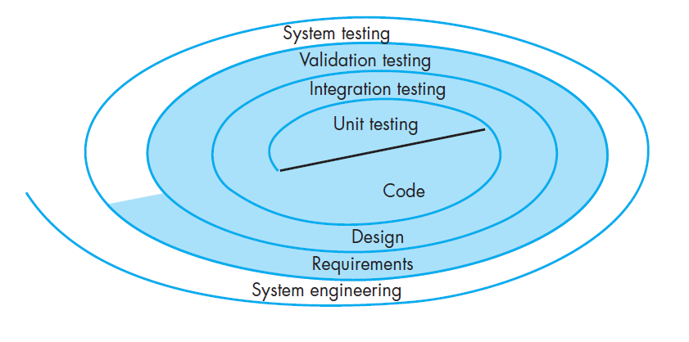
Software Testing Strategy

Slide 9
Discussion
Is it always possible to develop a strategy for testing software that uses the sequence of testing steps described in last slide?
What possible complications might arise for embedded systems?

Slide 10
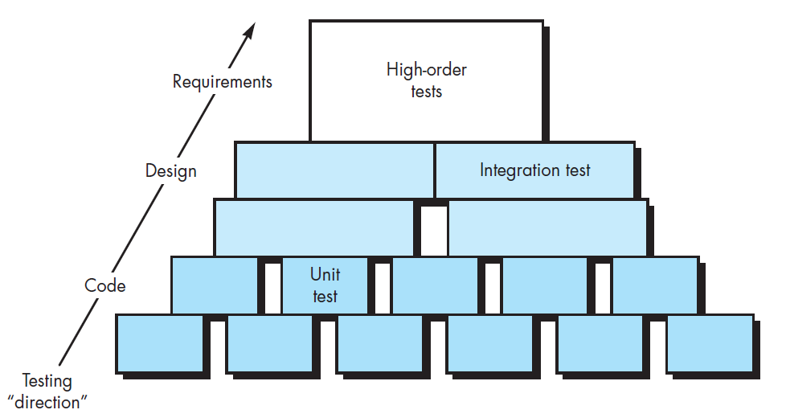
Software testing steps

Slide 11
Strategic Issues
specify product requirements in a quantifiable manner long before testing commences
state testing objectives explicitly
Understand the users of the software and develop a profile for each user category,
Develop a testing plan that emphasizes “rapid cycle testing,”
build “robust” software that is designed to test itself
use effective technical reviews as a filter prior to testing
Conduct technical reviews to assess the test strategy and test cases themselves, and
develop a continuous improvement approach (Chapter 37) for the testing process

Slide 12
Test Strategies for conventional software
Unit Testing
Integration Testing

Slide 13
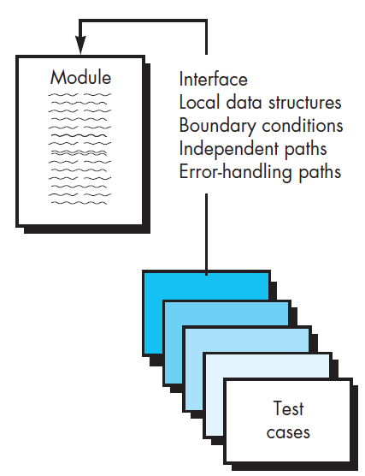
Unit Testing
Unit testing focuses verification effort on the smallest unit of software design— the software component or module
Using the component-level design description as a guide, important control paths are tested to uncover errors within the boundary of the module
The relative complexity of tests and the errors those tests uncover is limited by the constrained scope established for unit testing
The unit test focuses on the internal processing logic and data structures within the boundaries of a component
This type of testing can be conducted in parallel for multiple components

Slide 14
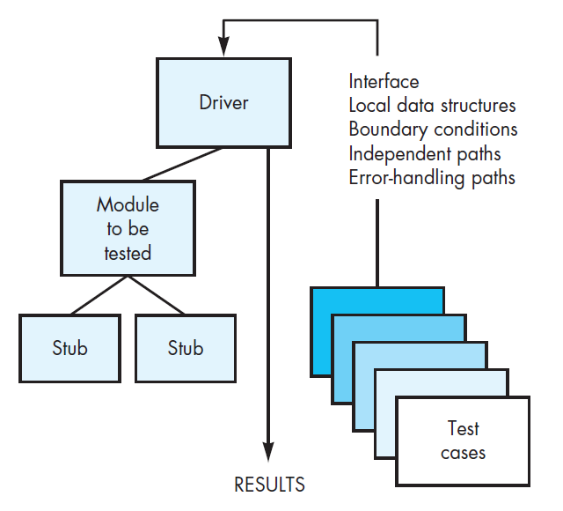
Unit test environment
In most applications a driver is nothing more than a “main program” that accepts test-case data, passes such data to the component (to be tested), and prints relevant results
Stubs serve to replace modules that are subordinate (invoked by) the component to be tested

Slide 15
Integration Testing
Integration testing is a systematic technique for constructing the software architecture while at the same time conducting tests to uncover errors associated with interfacing
The objective is to take unit-tested components and build a program structure that has been dictated by design

Slide 16
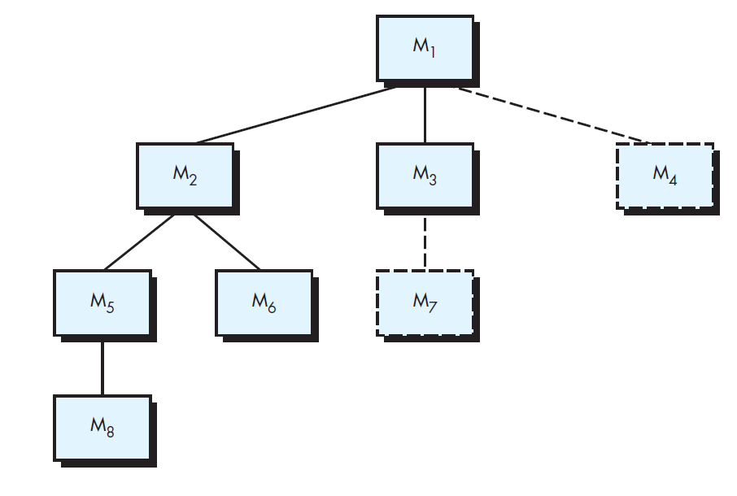
Top down Integration Depth first vs breadth first integration

Slide 17
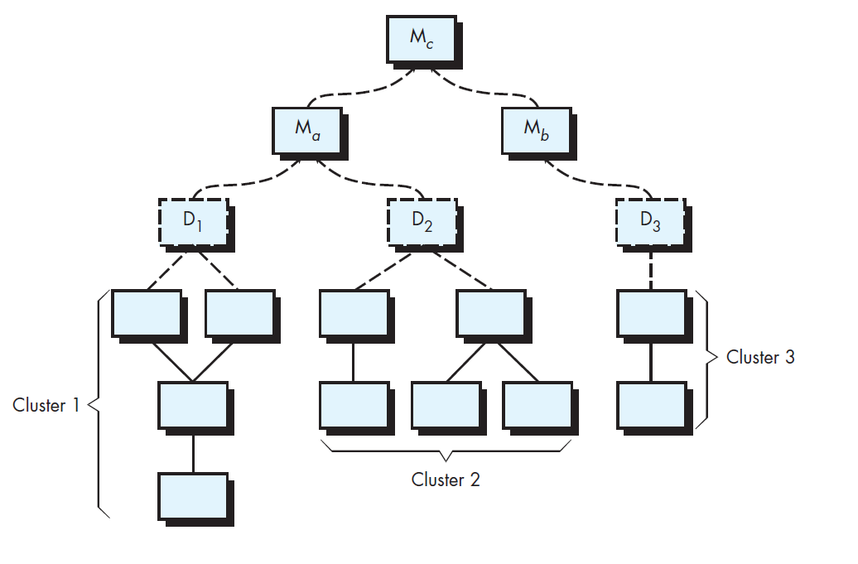
Bottom Up Integration

Slide 18
Regression Testing
Each time a new module is added as part of integration testing, the software changes
New data flow paths are established, new I/O may occur, and new control logic is invoked
Side effects associated with these changes may cause problems with functions that previously worked flawlessly
In the context of an integration test strategy, regression testing is the reexecution of some subset of tests that have already been conducted to ensure that changes have not propagated unintended side effects
Regression testing helps to ensure that changes (due to testing or for other reasons) do not introduce unintended behavior or additional errors

Slide 19
Regression Testing
The regression test suite (the subset of tests to be executed) contains three different classes of test cases:
A representative sample of tests that will exercise all software functions.
Additional tests that focus on software functions that are likely to be affected by the change
Tests that focus on the software components that have been changed

Slide 20
Smoke Testing
Smoke testing is an integration testing approach that is commonly used when product software is developed
It encompasses the following activities:
Software components that have been translated into code are integrated into a build
A series of tests is designed to expose errors that will keep the build from properly performing its function
The build is integrated with other builds, and the entire product (in its current form) is smoke tested daily
The integration approach may be top down or bottom up

Slide 21
Benefits of Smoke Tests
Integration risk is minimized
Because smoke tests are conducted daily, incompatibilities and other show-stopper errors are uncovered early, thereby reducing the likelihood of serious schedule impact when errors are uncovered
The quality of the end product is improved
Because the approach is construction (integration) oriented, smoke testing is likely to uncover functional errors as well as architectural and component-level design errors. If these errors are corrected early, better product quality will result.
Error diagnosis and correction are simplified
Like all integration testing approaches, errors uncovered during smoke testing are likely to be associated with “new software increments”
Progress is easier to assess
With each passing day, more of the software has been integrated and more has been demonstrated to work. This improves team morale and gives managers a good indication that progress is being made.

Slide 22
Test strategies for web apps
The content model for the WebApp is reviewed to uncover errors
The interface model is reviewed to ensure that all use cases can be accommodated.
The design model for the WebApp is reviewed to uncover navigation errors.
UI Testing
Each functional component is unit tested.
Navigation throughout the architecture is tested.
The WebApp is implemented in a variety of different environmental configurations and is tested for compatibility with each configuration
Security testing
Performance testing
The WebApp is tested by a controlled and monitored population of end users. The results of their interaction with the system are evaluated for errors

Slide 23
Test strategies for mobile apps
User-experience testing
Device compatibility testing
Performance testing. Testers check nonfunctional requirements unique to mobile devices (e.g., download times, processor speed, storage capacity, power availability).
Connectivity testing.
Security testing
Testing-in-the-wild . The app is tested under realistic conditions on actual user devices in a variety of networking environments around the globe.
Certification testing. Testers ensure that the MobileApp meets the standards established by the app stores that will distribute it.

Slide 24
Validation Testing
At the validation level, the distinction between different software categories disappears
Testing focuses on user-visible actions and user-recognizable output from the system
Validation Criteria along with user stories
Alpha-beta testing
Customer acceptance Testing

Slide 25
Discussion
Who should perform the validation test—the software developer or the software user?
Justify your answer

Slide 26
System Testing
Recovery Testing
Security Testing
Performance Testing
Deployment Testing
Stress Testing

Slide 27
Discussion
Identify a few non-functional tests to be performed for your project applications
Identify types of non-functional tests
Identify a few tests within those types

Slide 28
Summary
The objective of software testing is to uncover errors
For conventional software, this objective is achieved through a series of test steps. Unit and integration tests concentrate on functional verification of a component and incorporation of components into the software architecture
Validation testing demonstrates traceability to software requirements, and system testing validates software once it has been incorporated into a larger system
Each test step is accomplished through a series of systematic test techniques that assist in the design of test cases
With each testing step, the level of abstraction with which software is considered is broadened

Slide 29
Testing conventional/web/mobile applications
Pressman R S, Bruce R.Maxim, “Software engineering - A Practitioner’s Approach”, Eighth Edition, Tata McGraw-Hill, 2014
Chapter 23, 25, 26

Slide 30
Topics Covered
Topic | Text Book Reference
Testing conventional applications | 23.1, 23.2, 23.3, 23.6
Testing Web Apps | 25.1, 25.2, 25.3, 25.4, 25.7, 25.8, 25.9,
Testing Mobile Apps | 26.1, 26.2, 26.3

Slide 31
Testing fundamentals
The goal of testing is to find errors, and a good test is one that has a high probability of finding an error
Therefore, you should design and implement a computer-based system or a product with “testability” in mind
At the same time, the tests themselves must exhibit a set of characteristics that achieve the goal of finding the most errors with a minimum of effort
Testability - “ Software testability is simply how easily [a computer program] can be tested.”

Slide 32
Testability Characteristics
Testability
Operability
“The better it works, the more efficiently it can be tested.”
Observability
“What you see is what you test.”
Controllability
“The better we can control the software, the more the testing can be automated and optimized.”
Decomposability
“By controlling the scope of testing, we can more quickly isolate problems and perform smarter retesting.”
Simplicity
“The less there is to test, the more quickly we can test it.”
Stability
“The fewer the changes, the fewer the disruptions to testing.”
Understandability
“The more information we have, the smarter we will test.”

Slide 33
Test characteristics
A good test has a high probability of finding an error
A good test is not redundant
A good test should be “best of breed”
A good test should be neither too simple nor too complex

Slide 34
Internal and external views of testing
Black-box testing
allowed to tests that are conducted at the software interface.
A black-box test examines some fundamental aspect of a system with little regard for the internal logical structure of the software
White-box testing
of software is predicated on close examination of procedural detail
Logical paths through the software and collaborations between components are tested by exercising specific sets of conditions and/or loops

Slide 35
White box testing
White-box testing, sometimes called glass-box testing or structural testing, is a test-case design philosophy that uses the control structure described as part of component-level design to derive test cases
Using white-box testing methods, you can derive test cases that
(1) guarantee that all independent paths within a module have been exercised at least once,
(2) exercise all logical decisions on their true and false sides,
(3) execute all loops at their boundaries and within their operational bounds, and
(4) exercise internal data structures to ensure their validity.

Slide 36
Black box testing
Black-box testing , also called behavioral testing or functional testing, focuses on the functional requirements of the software
That is, black-box testing techniques enable you to derive sets of input conditions that will fully exercise all functional
requirements for a program
Black-box testing is not an alternative to white-box techniques
Rather, it is a complementary approach that is likely to uncover a different class of errors than white-box methods.

Slide 37
Black box testing
Black-box testing attempts to find errors in the following categories:
(1) incorrect or missing functions,
(2) interface errors,
(3) errors in data structures or external database access,
(4) behavior or performance errors, and
(5) initialization and termination errors.
Unlike white-box testing, which is performed early in the testing process, blackbox testing tends to be applied during later stages of testing

Slide 38
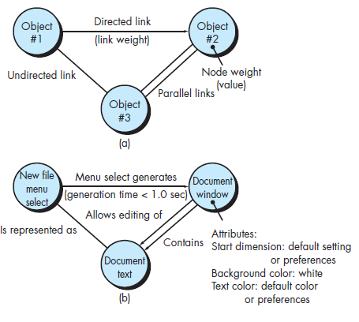
Graph-Based Testing Methods
The first step in black-box testing is to understand the objects that are modeled in software and the relationships that connect these objects
Once this has been accomplished, the next step is to define a series of tests that verify “all objects have the expected relationship to one another”

Slide 39
Graph-Based Testing Methods
You can then derive test cases by traversing the graph and covering each of the relationships shown
These test cases are designed in an attempt to find errors in any of the relationships

Slide 40
Discussion
Model any of the scenarios in your project and derive graph-based tests for the same.

Slide 41
Equivalence Partitioning
Equivalence partitioning is a black-box testing method that divides the input domain of a program into classes of data from which test cases can be derived
An ideal test case single-handedly uncovers a class of errors (e.g., incorrect processing of all character data) that might otherwise require many test cases to be executed before the general error is observed
An equivalence class represents a set of valid or invalid states for input conditions

Slide 42
Boundary value analysis
A greater number of errors occurs at the boundaries of the input domain rather than in the “center.”
It is for this reason that boundary value analysis (BVA) has been developed as a testing technique
Boundary value analysis leads to a selection of test cases that exercise bounding values
Boundary value analysis is a test-case design technique that complements equivalence partitioning
Rather than selecting any element of an equivalence class, BVA leads to the selection of test cases at the “edges” of the class

Slide 43
Summary
The primary objective for test-case design is to derive a set of tests that have the highest likelihood for uncovering errors in software
To accomplish this objective, two different categories of test-case design techniques are used: white-box testing and black-box testing
White-box tests focus on the program control structure. Test cases are derived to ensure that all statements in the program have been executed at least once during testing and that all logical conditions have been exercised\
Black-box tests are designed to validate functional requirements without regard to the internal workings of a program

Slide 44
Testing Web Applications
Chapter 25, 25.1, 25.2, 25.3, 25.4, 25.7, 25.8, 25.9

Slide 45
Dimensions of Quality
Content
Function
Structure
Usability
Navigability
Performance
Compatibility
Interoperability
Security

Slide 46
Errors within a WebApp Environment
Because many types of WebApp tests uncover problems that are first evidenced on the client side, you often see a symptom of the error, not the error itself
Because a WebApp is implemented in a number of different configurations and within different environments, it may be difficult or impossible to reproduce an error outside the environment in which the error was originally encountered
Although some errors are the result of incorrect design or improper HTML (or other programming language) coding, many errors can be traced to the WebApp configuration
Because WebApps reside within a client-server architecture, errors can be difficult to trace across three architectural layers: the client, the server, or the network itself
Some errors are due to the static operating environment (i.e., the specific configuration in which testing is conducted), while others are attributable to the dynamic operating environment

Slide 47
Testing Strategy
The content model for the WebApp is reviewed to uncover errors
The interface model is reviewed to ensure that all use cases can be accommodated
The design model for the WebApp is reviewed to uncover navigation errors
The user interface is tested to uncover errors in presentation and/or navigation mechanics
Selected functional components are unit tested
Navigation throughout the architecture is tested
The WebApp is implemented in a variety of different environmental configurations and is tested for compatibility with each configuration
Security tests are conducted in an attempt to exploit vulnerabilities in the WebApp or within its environment
Performance tests are conducted
The WebApp is tested by a controlled and monitored population of end users; the results of their interaction with the system are evaluated for content and navigation errors, usability concerns, compatibility concerns, and WebApp security, reliability, and performance.

Slide 48
Test Planning
A WebApp test plan identifies
the task set to be applied as testing commences,
the work products to be produced as each testing task is executed, and
the manner in which the results of testing are evaluated, recorded, and reused when regression testing is conducted

Slide 49
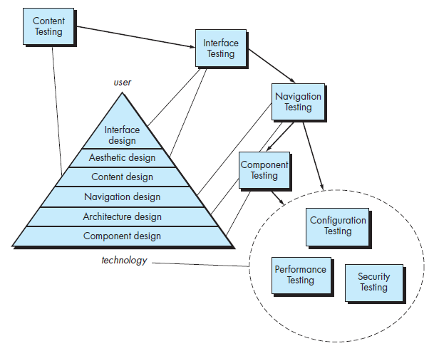
The testing Process

Slide 50
Content Testing
Content testing has three important objectives:
to uncover syntactic errors (e.g., typos, grammar mistakes) in text-based documents, graphical representations, and other media;
to uncover semantic errors (i.e., errors in the accuracy or completeness of information) in any content object presented as navigation occurs, and
to find errors in the organization or structure of content that is presented to the end user

Slide 51
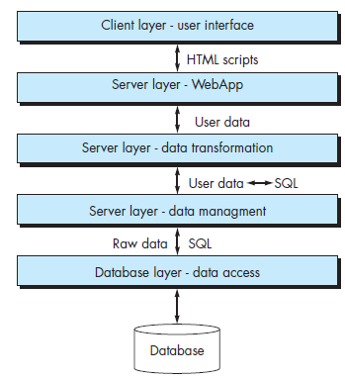
Content Testing Database Testing
WebApps interface with sophisticated database management systems and build dynamic content objects that are created in real time using the data acquired from a database
For example, a financial services WebApp can produce complex text-based, tabular, and graphical information about a specific equity (e.g., a stock or mutual fund)
The composite content object that presents this information is created dynamically after the user has made a request for information about a specific equity

Slide 52
Content Testing Database Testing
an equities database is queried,
relevant data are extracted from the database,
the extracted data must be organized as a content object, and
this content object (representing customized information requested by an end user) is transmitted to the client environment for display

Slide 53
Content Testing Database Testing – Complicating factors
The original client-side request for information is rarely presented in the form [e.g. SQL] that can be input to a database management system (DBMS)
Therefore, tests should be designed to uncover errors made in translating the user’s request into a form that can be processed by these DBMS
The database may be remote to the server that houses the WebApp
Therefore, tests that uncover errors in communication between the WebApp and the remote database must be developed

Slide 54
Content Testing Database Testing – Complicating factors
Raw data acquired from the database must be transmitted to the WebApp server and properly formatted for subsequent transmittal to the client
Therefore, tests that demonstrate the validity of the raw data received by the WebApp server must be developed, and additional tests that demonstrate the validity of the transformations applied to the raw data to create valid content objects must also be created
The dynamic content object(s) must be transmitted to the client in a form that can be displayed to the end user
Therefore, a series of tests must be designed to (1) uncover errors in the content object format and (2) test compatibility with different client environment configurations

Slide 55
User Interface Testing
Verification and validation of a WebApp user interface occurs at three distinct points
During requirements analysis, the interface model is reviewed to ensure that it conforms to stakeholder requirements and to other elements of the requirements model
During design the interface design model is reviewed to ensure that generic quality criteria established for all user interfaces have been achieved and that application-specific interface design issues have been properly addressed
During testing, the focus shifts to the execution of application-specific aspects of user interaction as they are manifested by interface syntax and semantics. In addition, testing provides a final assessment of usability

Slide 56
Interface Testing Strategy
Interface testing exercises interaction mechanisms and validates aesthetic aspects of the user interface
The overall strategy for interface testing is to
Uncover errors related to specific interface mechanisms (e.g., errors in the proper execution of a menu link or the way data are entered in a form) and
Uncover errors in the way the interface implements the semantics of navigation, WebApp functionality, or content display

Slide 57
Testing Interface Mechanisms
Links
Forms
Client side scripting
Dynamic HTML
Pop up windows
Streaming content
Cookies
Application specific interface mechanisms

Slide 58
Usability Testing
Usability testing can occur at a variety of different levels of abstraction:
the usability of a specific interface mechanism (e.g., a form) can be assessed,
the usability of a complete Web page (encompassing interface mechanisms, data objects, and related functions) can be evaluated, or
the usability of the complete WebApp can be considered

Slide 59
Usability Testing Usability categories
Interactivity
Layout
Readability
Aesthetics
Display characteristics
Time sensitivity
Personalization
Accessibility

Slide 60
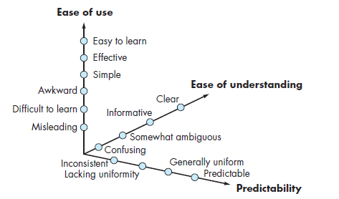
Usability Testing Qualitative assessment of usability
Figure illustrates possible set of assessment “grades” that can be selected by users
These grades are applied to each feature individually, to a complete Web page, or to the WebApp as a whole

Slide 61
Compatibility Tests
Different computers, display devices, operating systems, browsers, and network connection speeds can have a significant influence on WebApp operation
Each computing configuration can result in differences in client-side processing speeds, display resolution, and connection speeds
Operating system vagaries may cause WebApp processing issues
Different browsers sometimes produce slightly different results, regardless of the degree of HTML standardization within the WebApp
Required plug-ins may or may not be readily available for a particular configuration
Compatibility testing strives to uncover these problems before the WebApp goes online

Slide 62
Compatibility Tests
The first step in compatibility testing is to define a set of “commonly encountered” client-side computing configurations and their variants
In essence, a tree structure is created, identifying each computing platform, typical display devices, the operating systems supported on the platform, the browsers available, likely Internet connection speeds, and similar information
Next, a series of compatibility validation tests are derived, often adapted from existing interface tests, navigation tests, performance tests, and security tests
The intent of these tests is to uncover errors or execution problems that can be traced to configuration differences

Slide 63
Discussion
Compatibility is an important quality dimension. What must be tested to ensure that compatibility exists for a WebApp?

Slide 64
CONFIGURATION TESTING
25.7

Slide 65
Configuration Testing
Configuration variability and instability are important factors that make WebApp testing a challenge
Hardware, OS, browsers, storage capacity etc are difficult to predict for each user
The result can be a client-side environment that is prone to errors that are both subtle and significant
One user’s impression of the WebApp and the manner in which she interacts with it can differ significantly from another user’s experience, if both users are not working within the same client-side configuration
The job of configuration testing is not to exercise every possible client-side configuration
Rather, it is to test a set of probable client-side and server-side configurations to ensure that the user experience will be the same on all of them and to isolate errors that may be specific to a particular configuration

Slide 66
Discussion
Which errors tend to be more serious—client-side errors or server-side errors? Why?

Slide 67
SECURITY TESTING
25.8

Slide 68
Security Testing
WebApp security is a complex subject that must be fully understood before effective security testing can be accomplished
WebApps and the client-side and server-side environments in which they are housed represent an attractive target for external hackers, disgruntled employees, dishonest competitors, and anyone else who wishes to steal sensitive information, maliciously modify content, degrade performance, disable functionality, or embarrass a person, organization, or business

Slide 69
Security Testing
Security tests are designed to probe vulnerabilities of the client-side environment, the network communications that occur as data are passed from client to server and back again, and the server-side environment
Each of these domains can be attacked, and it is the job of the security tester to uncover weaknesses that can be exploited by those with the intent to do so
On the client side, vulnerabilities can often be traced to preexisting bugs in browsers, e-mail programs, or communication software
On the server side, vulnerabilities include denial-of-service attacks and malicious scripts that can be passed along to the client side or used to disable server operations
In addition, server-side databases can be accessed without authorization (data theft)

Slide 70
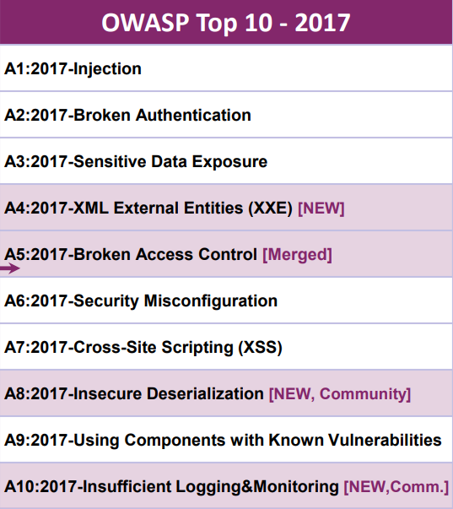
OWASP Top 10 attacks
Not from Text book
But extremely useful to understand
https://www.veracode.com/directory/owasp-top-10

Slide 71
OWASP Top 10 attacks Three of them from security testing perspective
Injection
Injection flaws, such as SQL injection, LDAP injection, and CRLF injection, occur when an attacker sends untrusted data to an interpreter that is executed as a command without proper authorization.
Broken Access Control
Application security testing can easily detect injection flaws. Developers should use parameterized queries when coding to prevent injection flaws
Improperly configured or missing restrictions on authenticated users allow them to access unauthorized functionality or data, such as accessing other users’ accounts, viewing sensitive documents, and modifying data and access rights.
Penetration testing is essential for detecting non-functional access controls; other testing methods only detect where access controls are missing
Cross-Site Scripting
Cross-site scripting (XSS) flaws give attackers the capability to inject client-side scripts into the application, for example, to redirect users to malicious websites.
Developer training complements security testing to help programmers prevent cross-site scripting with best coding best practices, such as encoding data and input validation.

Slide 72
Performance TESTING
25.9

Slide 73
Performance Testing
Performance testing is used to uncover performance problems that can result from a lack of server-side resources, inappropriate network bandwidth, inadequate database capabilities, faulty or weak operating system capabilities, poorly designed WebApp functionality, and other hardware or software issues that can lead to degraded client-server performance
The intent is twofold:
to understand how the system responds as loading (i.e., number of users, number of transactions, or overall data volume), and
to collect metrics that will lead to design modifications to improve performance

Slide 74
Performance Testing Questions to be answered
Does the server response time degrade to a point where it is noticeable and unacceptable?
At what point (in terms of users, transactions, or data loading) does performance become unacceptable?
What system components are responsible for performance degradation?
What is the average response time for users under a variety of loading conditions?
Does performance degradation have an impact on system security?
Is WebApp reliability or accuracy affected as the load on the system grows?
What happens when loads that are greater than maximum server capacity are applied?
Does performance degradation have an impact on company revenues?

Slide 75
Load Testing
The intent of load testing is to determine how the WebApp and its server-side environment will respond to various loading conditions
As testing proceeds, permutations to the following variables define a set of test conditions:
N, number of concurrent users
T, number of online transactions per unit of time
D, data load processed by the server per transaction

Slide 76
Load Testing
The intent of load testing is to determine how the WebApp and its server-side environment will respond to various loading conditions
As testing proceeds, permutations to the following variables define a set of test conditions:
N, number of concurrent users
T, number of online transactions per unit of time
D, data load processed by the server per transaction
You should examine these measures to determine whether a decrease in performance can be traced to a specific combination of N, T, and D

Slide 77
Load Testing
Load testing can also be used to assess recommended connection speeds for users of the WebApp
Overall throughput, P, is computed in the following manner:
P = N * T * D
As an example, consider a popular sports news site. At a given moment, 20,000 concurrent users submit a request (a transaction, T ) once every 2 minutes on average. Each transaction requires the WebApp to download a new article that averages 3K bytes in length. Therefore, throughput can be calculated as:
P = [20,000 * 0.5 * 3Kb]/60 = 500 Kbytes/sec
= 4 megabits per second
The network connection for the server would therefore have to support this data rate and should be tested to ensure that it does

Slide 78
Stress Testing
Stress testing is a continuation of load testing, but in this instance the variables, N, T, and D are forced to meet and then exceed operational limits
The intent of these tests is to answer each of the following questions:
Does the system degrade “gently,” or does the server shut down as capacity is exceeded?
Does server software generate “server not available” messages? More generally, are users aware that they cannot reach the server?
Does the server queue resource requests and empty the queue once capacity demands diminish?
Are transactions lost as capacity is exceeded?
…..

Slide 79
Summary
The goal of WebApp testing is to exercise each of the many dimensions of WebApp quality with the intent of finding errors or uncovering issues that may lead to quality failures
Testing focuses on content, function, structure, usability, navigability, performance, compatibility, interoperability, capacity, and security

Slide 80
Testing Mobile Applications
Chapter 26, 26.1, 26.2, 26.3

Slide 81
Mobile App Testing
There are several important questions to ask when creating a MobileApp testing strategy
Do you have to build a fully functional prototype before you test with users?
Should you test with the user’s device or provide a device for testing?
What devices and user groups should you include in testing?
What are the benefits/drawbacks of lab testing versus remote testing?

Slide 82
Testing Guidelines
Understand the network and device landscape before testing to identify bottlenecks
Conduct tests in uncontrolled real-world test conditions
Select the right automation test tool
Use the Weighted Device Platform Matrix method to identify the most critical hardware/platform combination to test
Check the end-to-end functional flow in all possible platforms at least once
Conduct performance testing, GUI testing, and compatibility testing using actual devices
Measure performance only in realistic conditions of wireless traffic and user load

Slide 83
MobileApp Testing - Checklist
Conceptual
Unit and System
Ux
Stability
Connectivity
Performance
Device Compatibility
Security
Certification

Slide 84
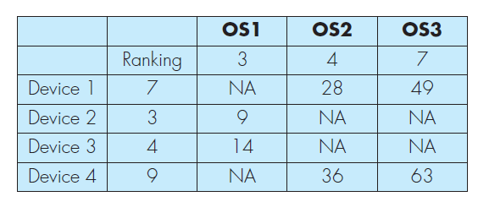
Building a test matrix
A weighted device platform matrix (WDPM) helps ensure that test coverage includes each combination of mobile device and context variables
The WDPM can also be used to help prioritize the device/context combinations so that the most important are tested first

Slide 85
Building a test matrix
list the important operating system variants as the matrix column labels
list the targeted devices as the matrix row labels
assign a ranking (e.g., 0 to 10) to indicate the relative importance of each operating system and each device, and
compute the product of each pair of rankings and enter each product as the cell entry in the matrix

Slide 86
Stress Testing
Stress testing for mobile apps attempts to find errors that will occur under extreme operating conditions
In addition, it provides a mechanism for determining whether the MobileApp will degrade gracefully without compromising security
Among the many actions that might create extreme conditions are:
running several mobile apps on the same device,
infecting system software with viruses or malware,
attempting to take over a device and use it to spread spam,
forcing the mobile app to process inordinately large numbers of transactions, and
storing inordinately large quantities of data on the device

Slide 87
Testing in a Production Environment
Many MobileApp developers advocate testing-in-the-wild , or testing in the users’ native environments with the production release versions of the MobileApp resources
Some of the characteristics of in-the-wild testing include adverse and unpredictable environments, outdated browsers and plug-ins, unique hardware, and imperfect connectivity
Creating test environments in-house is an expensive and error-prone process
Cloud-based testing can offer a standardized infrastructure and preconfigured software images, freeing the MobileApp team from the need to worry about finding servers or purchasing their own licenses for software and testing tools

Slide 88
CONSIDERING THE SPECTRUM OF USER INTERACTION
Gesture Testing
Voice Input and Recognition
Virtual Key Board Input
Alerts and Extraordinary Conditions

Slide 89
Summary
The goal of MobileApp testing is to exercise each of the many dimensions of MobileApp quality with the intent of finding errors or uncovering issues that may lead to quality failures
Testing focuses on quality elements such as content, function, structure, usability, use of context, navigability, performance, power management, compatibility, interoperability, capacity, and security
It incorporates reviews and usability assessments that occur as the MobileApp is designed, and tests that are conducted once the MobileApp has been implemented and deployed on an actual device

